Slide 1
LALITHA-19000570
DEDALUS

Slide 2
About
This app is designed to simplify leave request process
Have admin and user flow
Used json auth server to fetch data
User can request for leave and also can see the history
Admin can approve/reject the request and also can see the history of all the request from all users
No where in the code used data is hard coded

Slide 3
Flow Diagram
LOGIN/REGISTER
SUCCESS
USER
SEE HISTORY AND STATUS
REQUEST FOR NEW LEAVE
ADMIN
APPROVE/REJECT
SEE HISTORY AND STATUS
FAIL
ERROR:INVALID
REQUEST WILL BE SENT TO ADMIN
RESULT WILL BE UPDATED IN JSON FILE VIA AUTH SERVICE

Slide 4
Login Component
Login component loads by default and User/Admin can login through the window
Dedalus logo is designed to transform
Logo is stored in Nginx sever
Login page is deigned with div
On click it will call login function and which is defined in login service
It will get the emailed and password and fetch access Token along with user details
On success it will store access Token ,emp name and emp id in session storage
On fail it will alert 'Invalid Credentials'

Slide 5
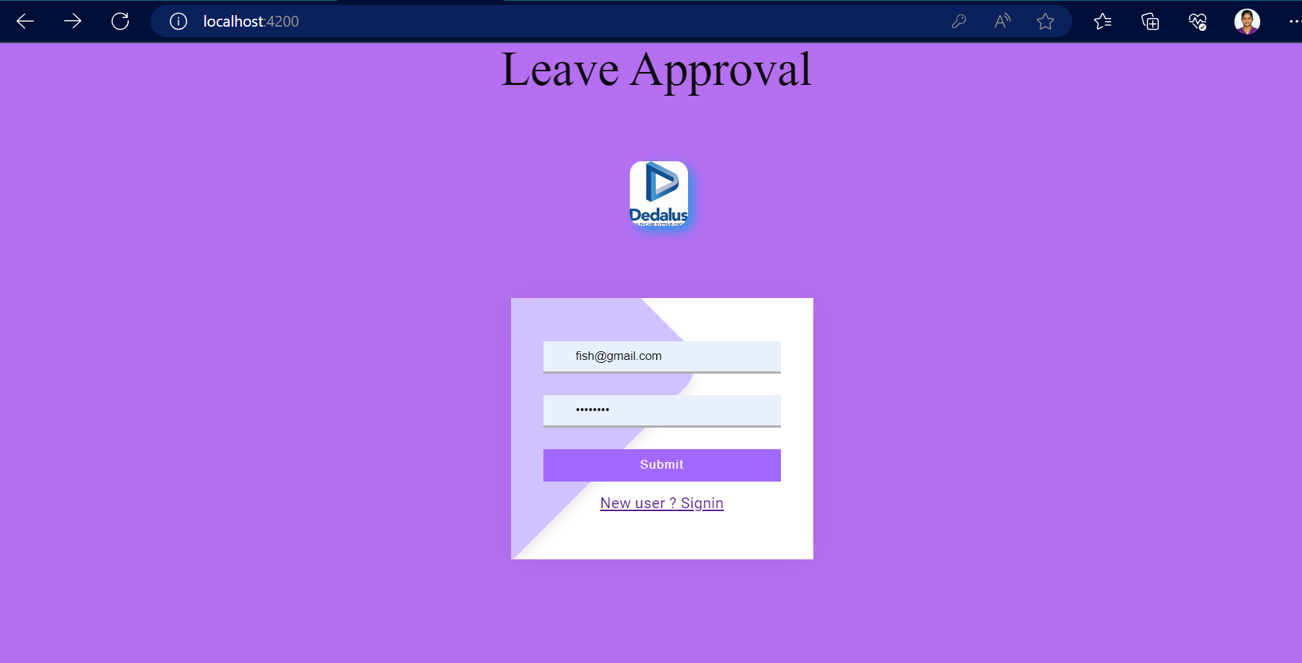

Slide 6
REGISTER COMPONENT
For first time login users can click to the signup link , it will navigate to the register component
It will ask for some mandatory information like email Id , name , password, account type, employee id .
This fields validation done on server side .
After entering valid details all the values are passed to the service layer and with the help of postRgister() function in login service layer will post http://localhost:4500/660/signup in the following call .
After success full register user will be navigated to login page

Slide 7
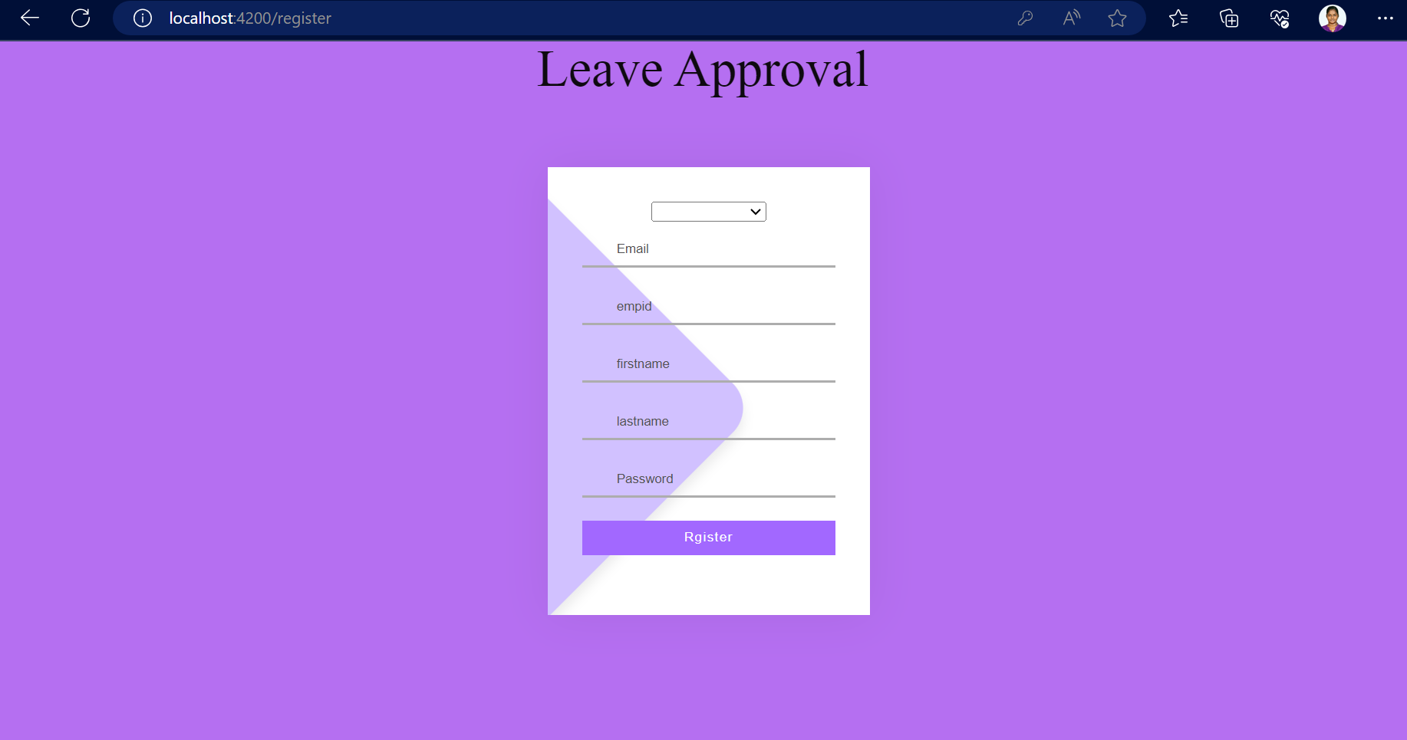

Slide 8
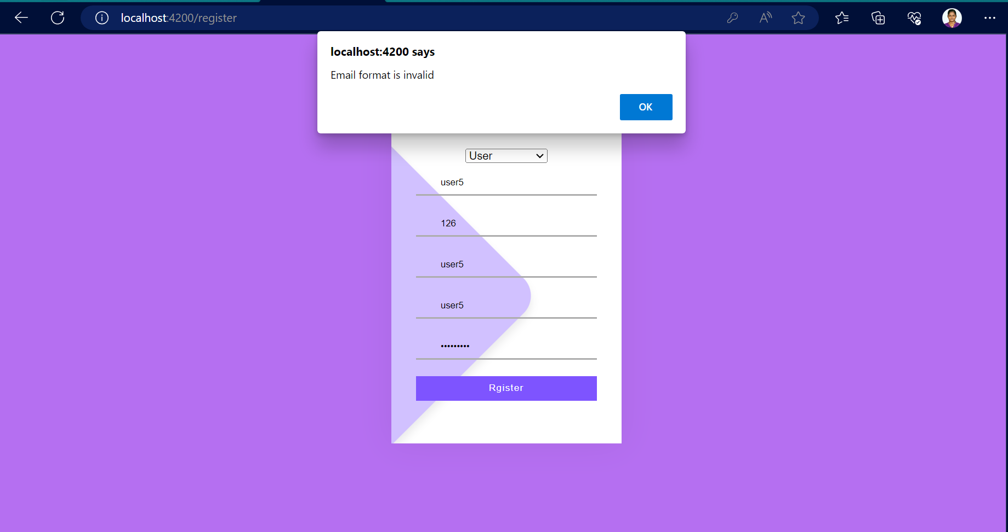

Slide 9
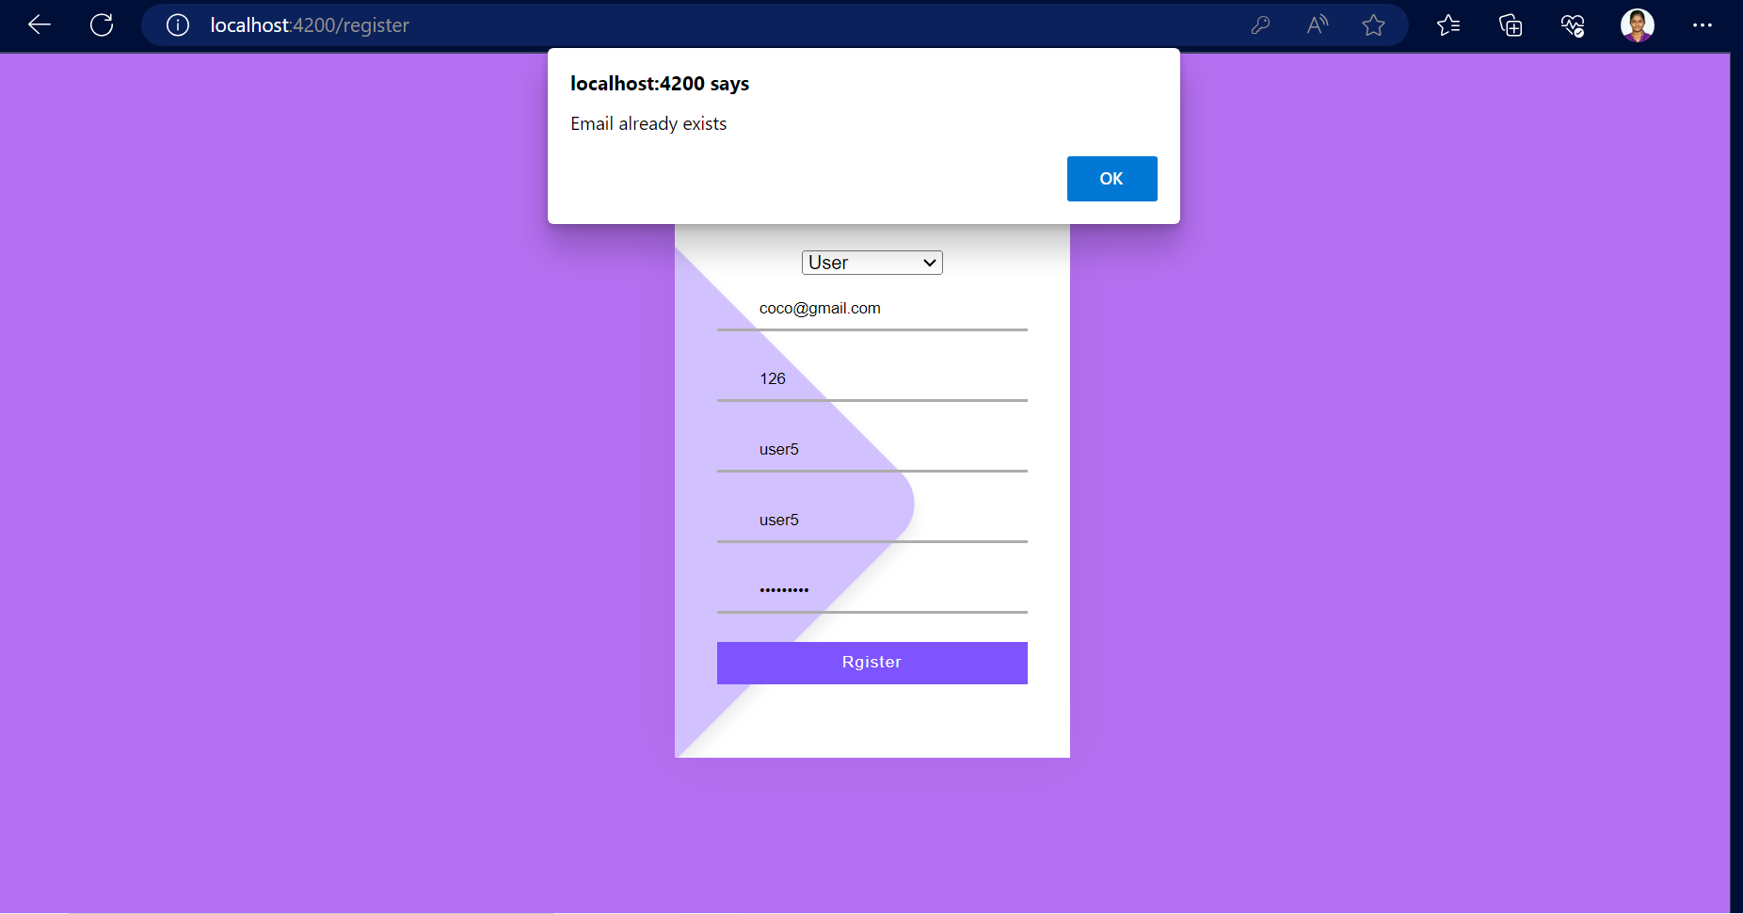

Slide 10
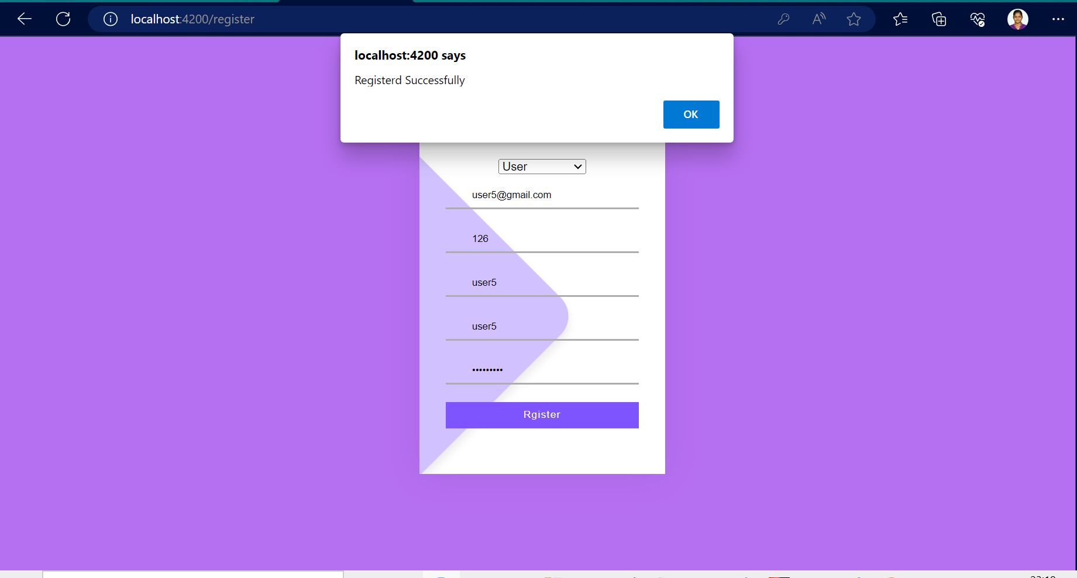

Slide 11
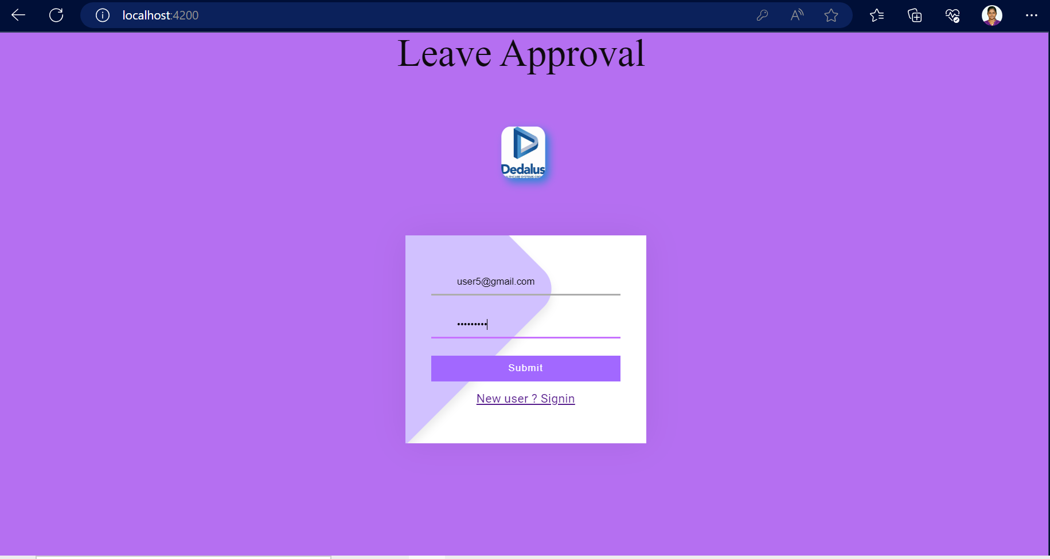

Slide 12
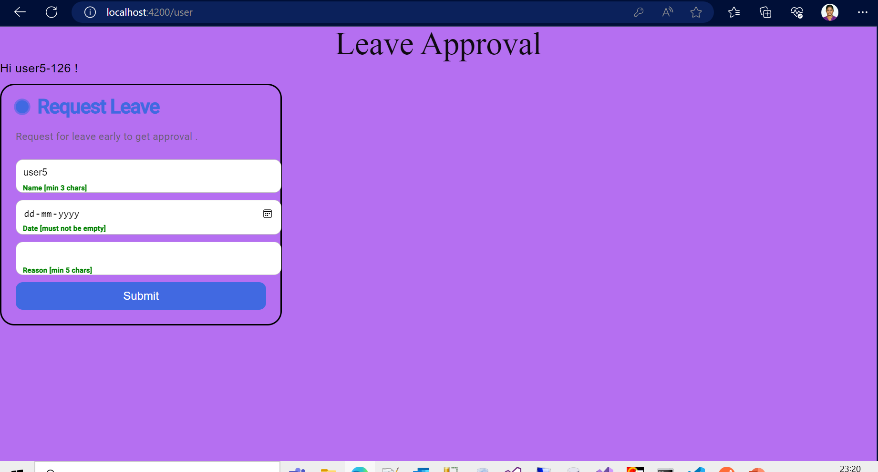

Slide 13
Routing
While login it will validate the length of the fields where not zero ,if it is zero it will throw validation error (attached in the next slide)
After Successful login it will check for login type if it is an admin login it will load admin component or if it is a user login then it will load a user component.
Routing paths were defined in app-routing module
Respective paths were called in login function accordingly.

Slide 14
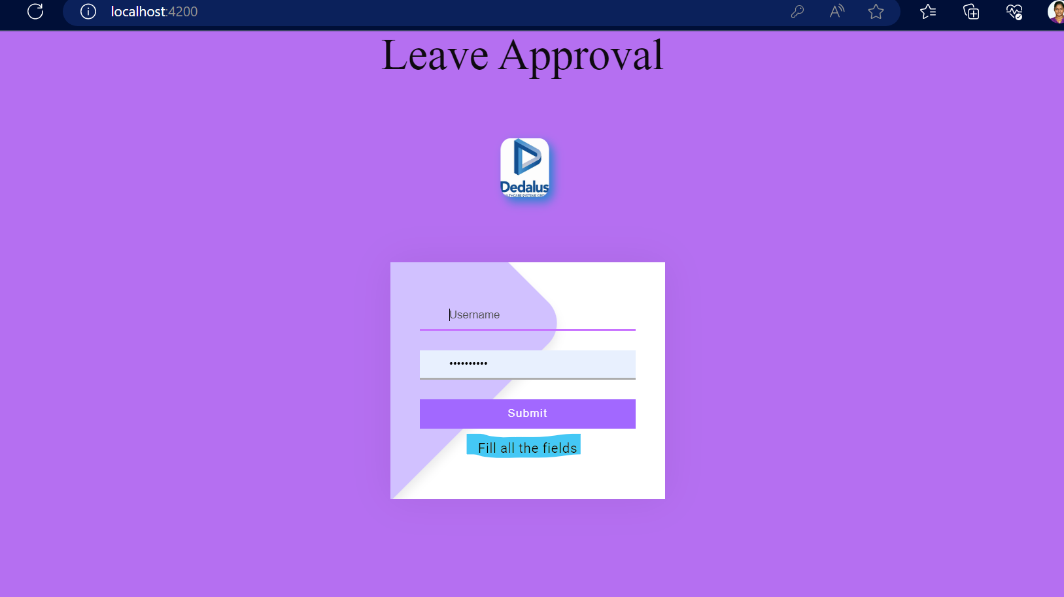

Slide 15
User Component –History component
After successful login of user account user component will be loaded .
As mentioned earlier token ,name & id are stored in session storage .
Using ‘getleavereq()’ service we will get all the leave request from json file.
From session storage emp id where taken and passed to the pipe ‘empid’ so out of all the leave requests , logged particular employee’s leave request where filtered via pipe we will get the leave requests associated with the logged user will be displayed .
In ‘getleavereq()’ service secured api is called ‘http://localhost:4500/660/leavereq’ with Authorization token .
Value of authorization token will be taken from session storage .
On successful get call array of leave request objects will be returned .In fails return empty array.
For each object history component’ selector will be instantiated ,this is achieved using ngfor.

Slide 16
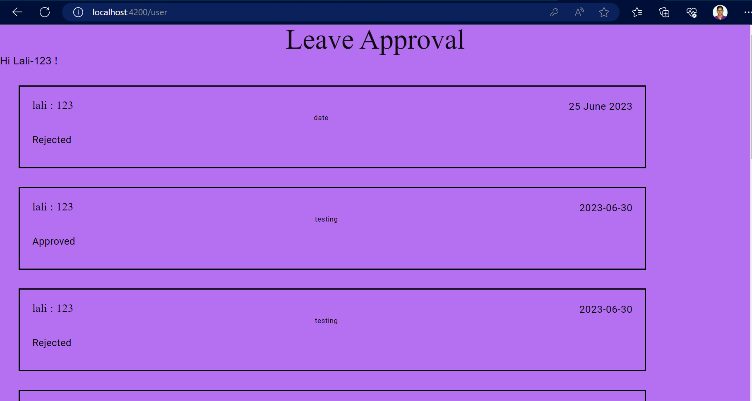

Slide 17
User Component –Leavereq component
At the end of the user page added form to make request to the admin .
Employee id and employee name will be passed to the leavereq component which contains the form .
This form is implemented based on template driven approach.
Data will be validated using form builder.
After validation data will be passed to service ,where secured postleavereq() post call will be called and updates json.
Since it is updated in json the leave request with pending status will be updated in history and it sends the request to admin also.
If fails to post the data ,error ‘Something went wrong’ will be alert
All the process will be attached as screen shots in the upcoming slides.

Slide 18
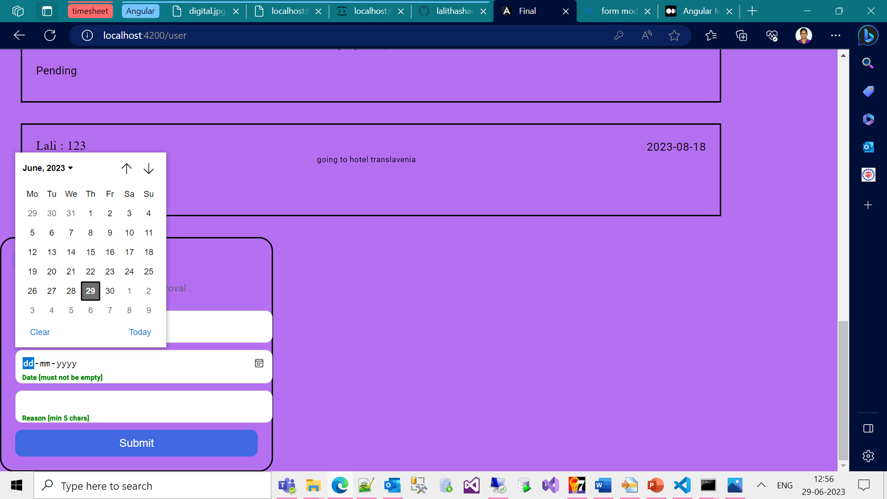

Slide 19
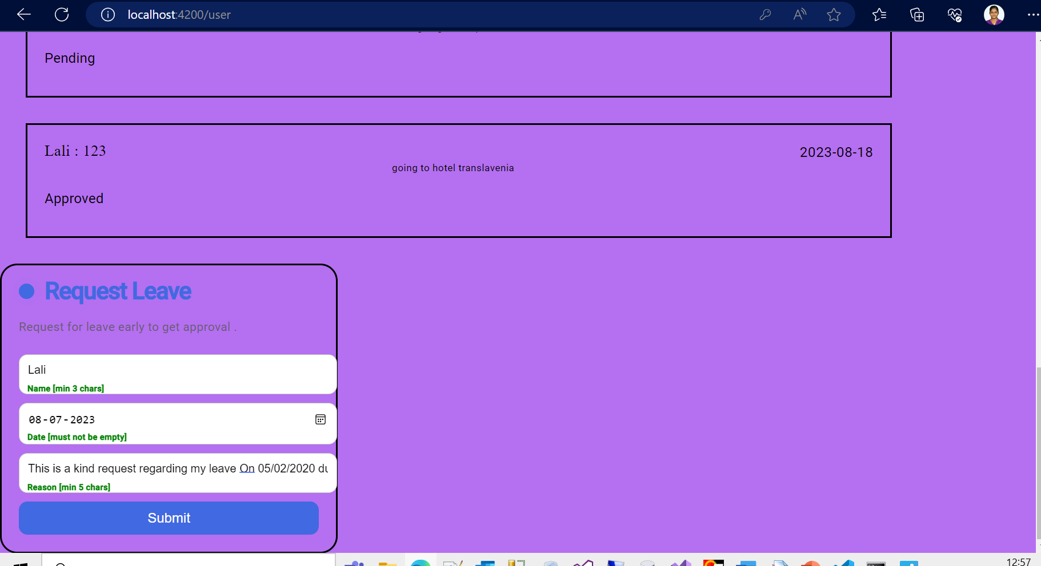

Slide 20
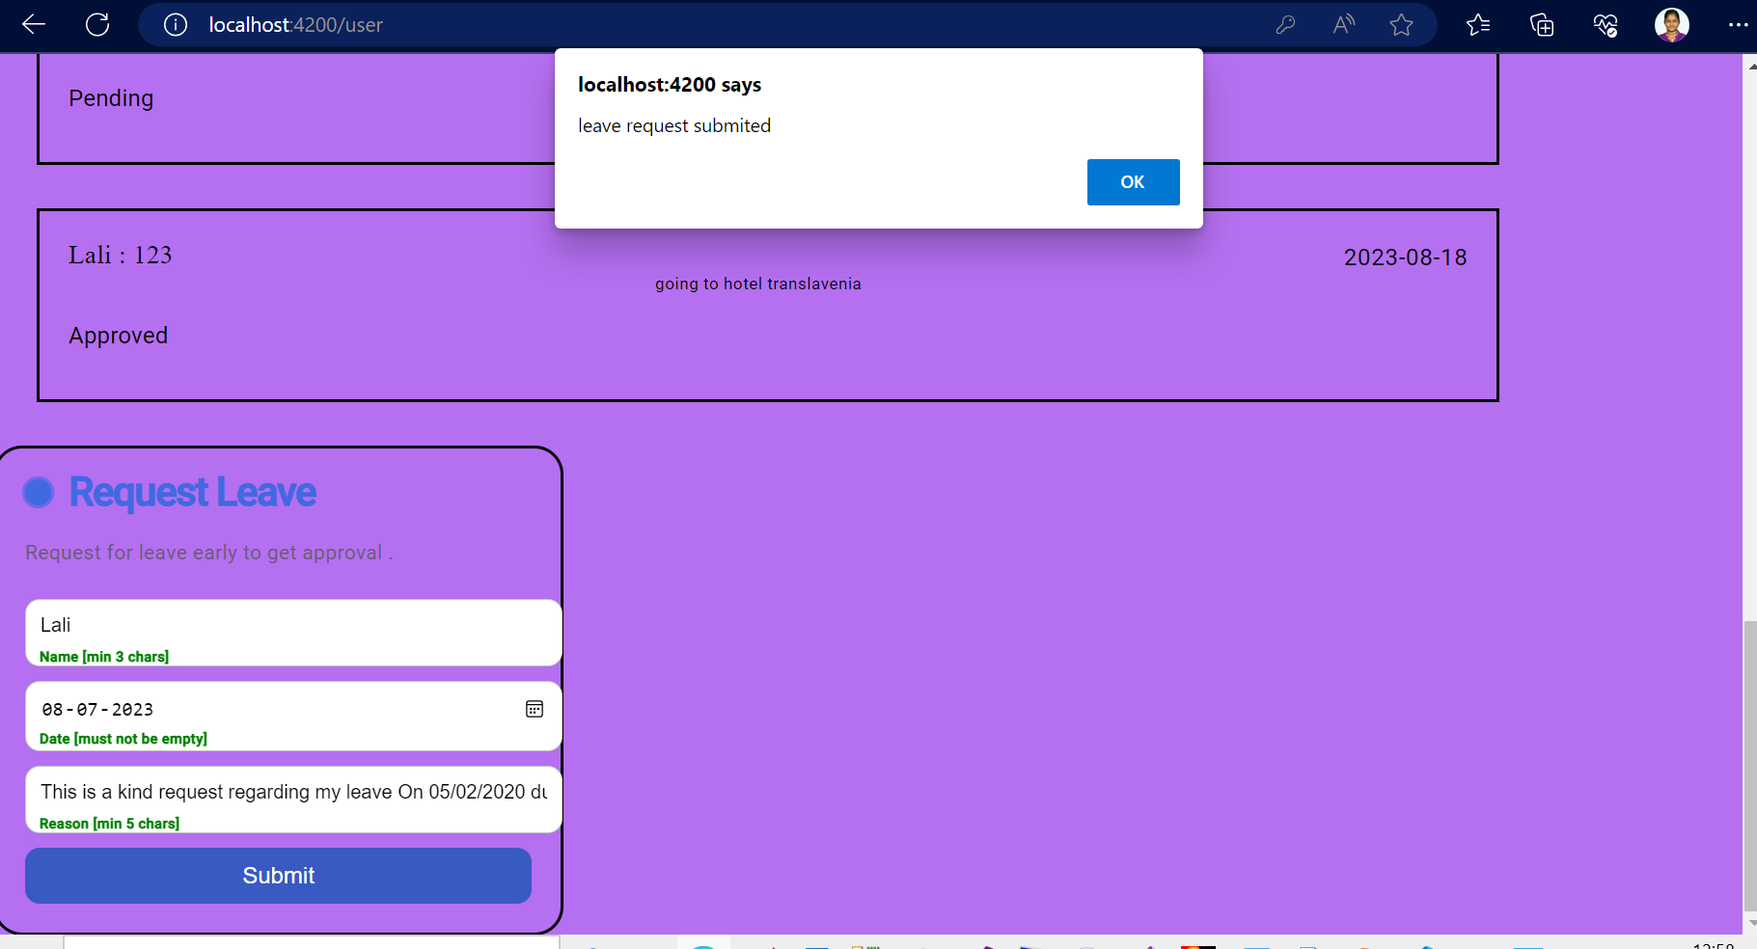

Slide 21
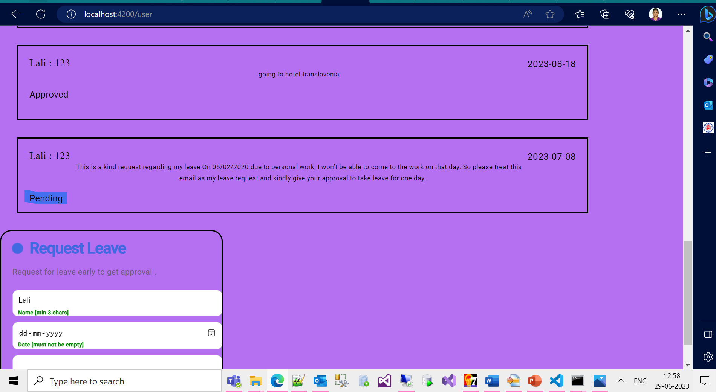

Slide 22
Admin Component
The request post by all the users will be displayed in the Admin window .
Using ‘getleavereq()’ service we will get all the leave request from json file.
The url is securen by json auth token validation , the url: http://localhost:4500/660/leavereq
Authorization token value will be taken from Session storage.
Request component inside the Admin component will be instantiated multiple times as of returned request .
By default the request status is ‘Pending’ so it will show both grant and dismiss button
Status of the request will be displayed the left down in each of request component

Slide 23
Admin Component –Request Component
Once the request is approved by the Admin then the status of that request is changed to ‘Approved’ and only ‘dismiss’ button will be displayed .
the request is Dismissed by the Admin then the status of that request is changed to ‘Rejected’ and only ‘Grant’ button will be displayed .
This behavior is achieved using ngif.
While clicking grant/dismiss button secured patch request is sent via patchleavereq() sevice.
Each button is differentiated in the ts file of request component in two different functions updateApprove() and updateReject().
After every successful patch call respective alert will be thrown to ensure the same.
At anytime the requests status can be altered.

Slide 24
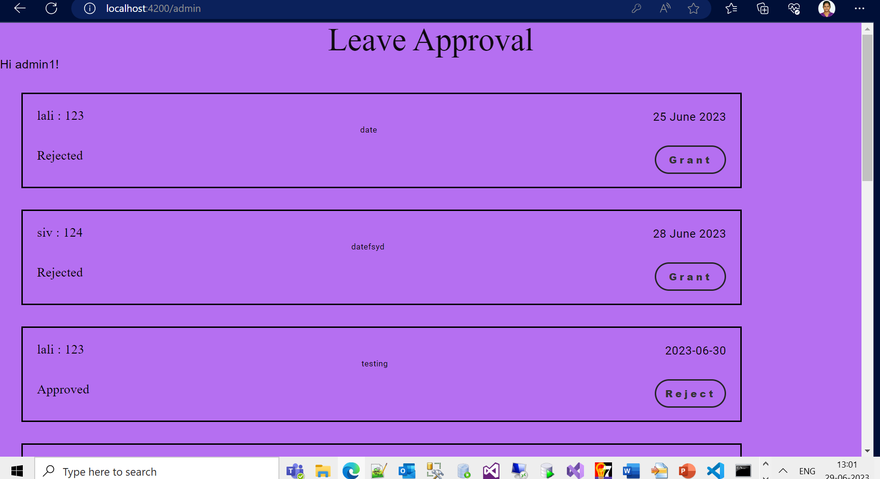

Slide 25
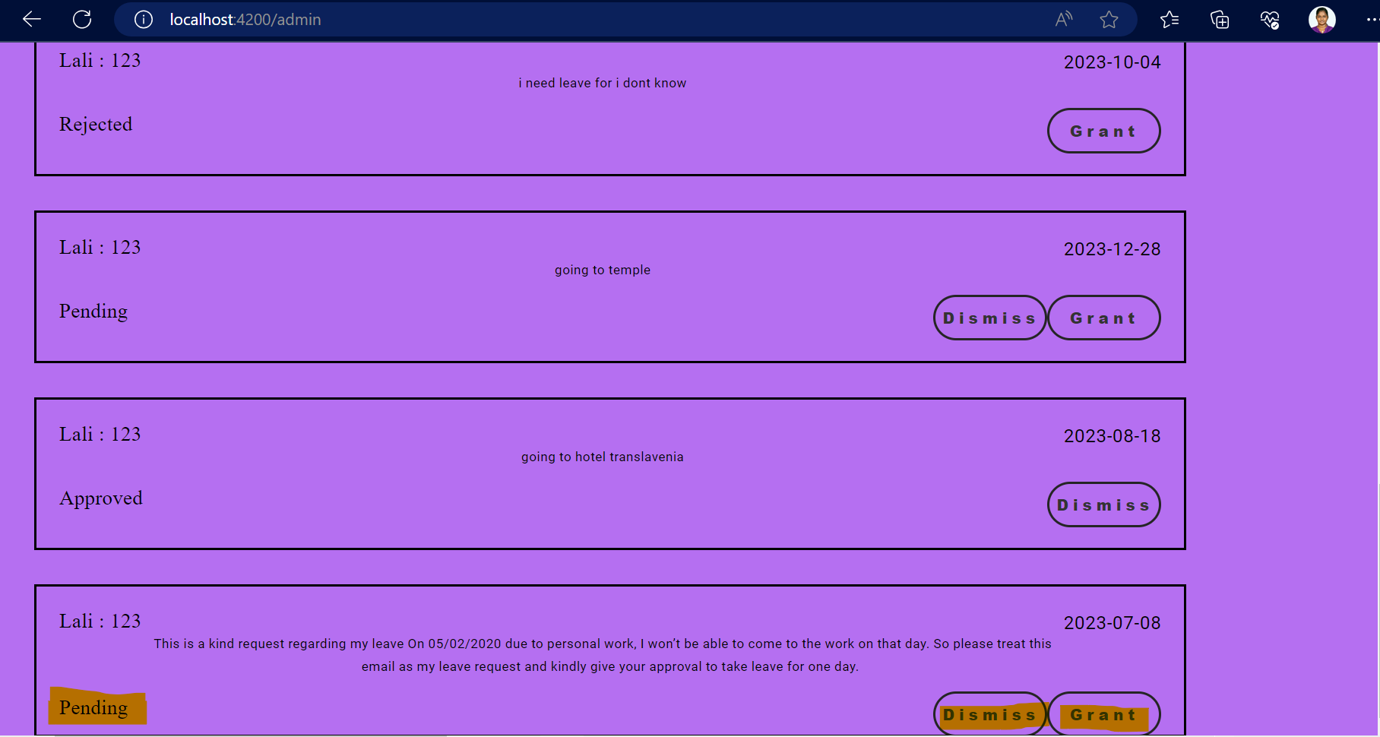

Slide 26
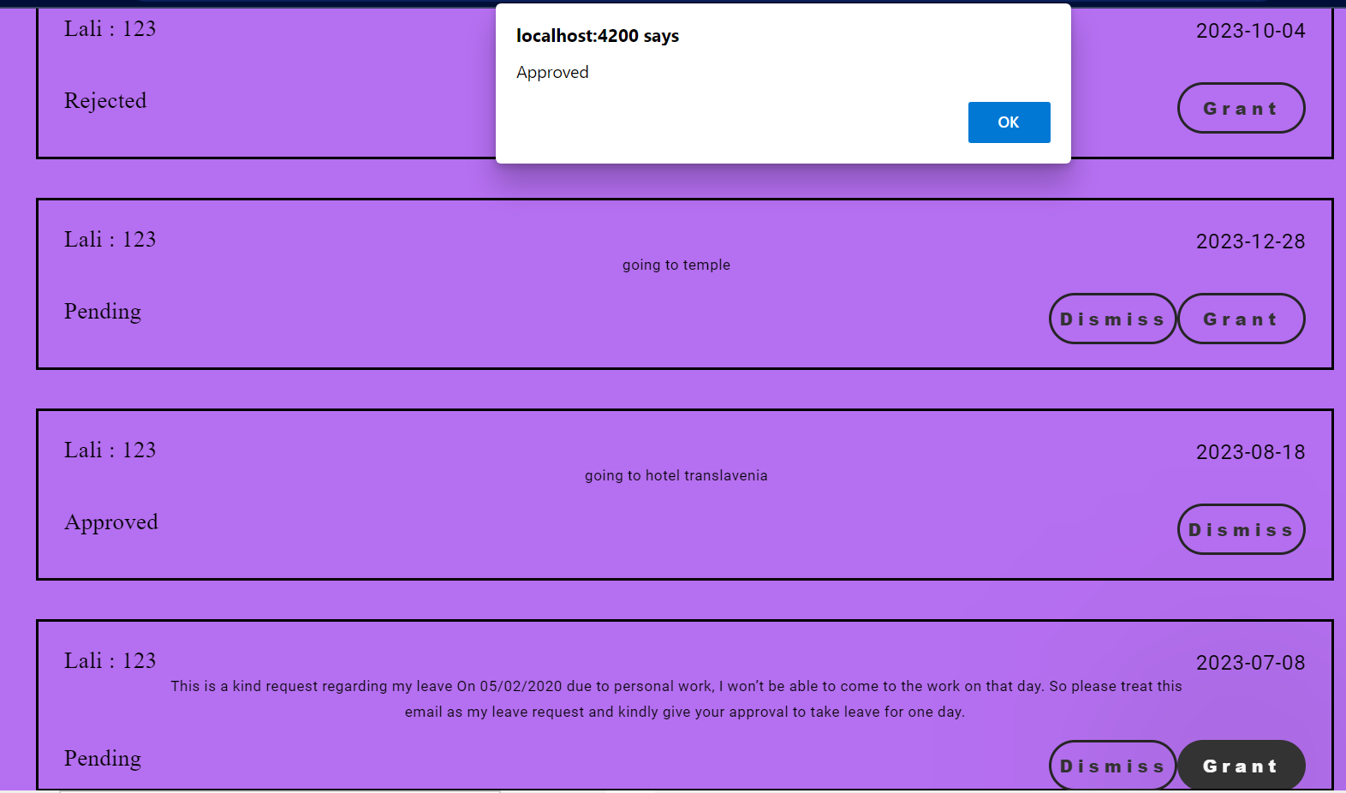
Admin view After clicking Grant

Slide 27
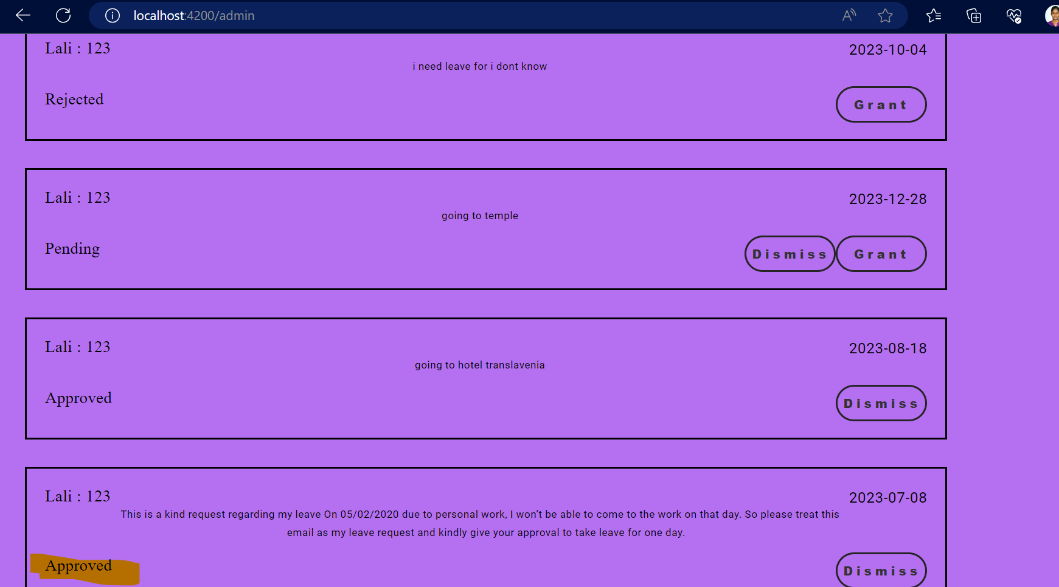

Slide 28
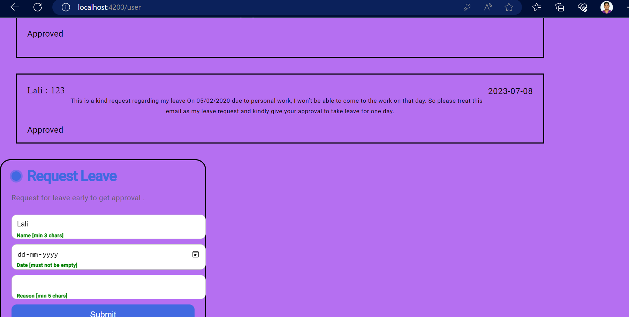
In User view after accept

Slide 29
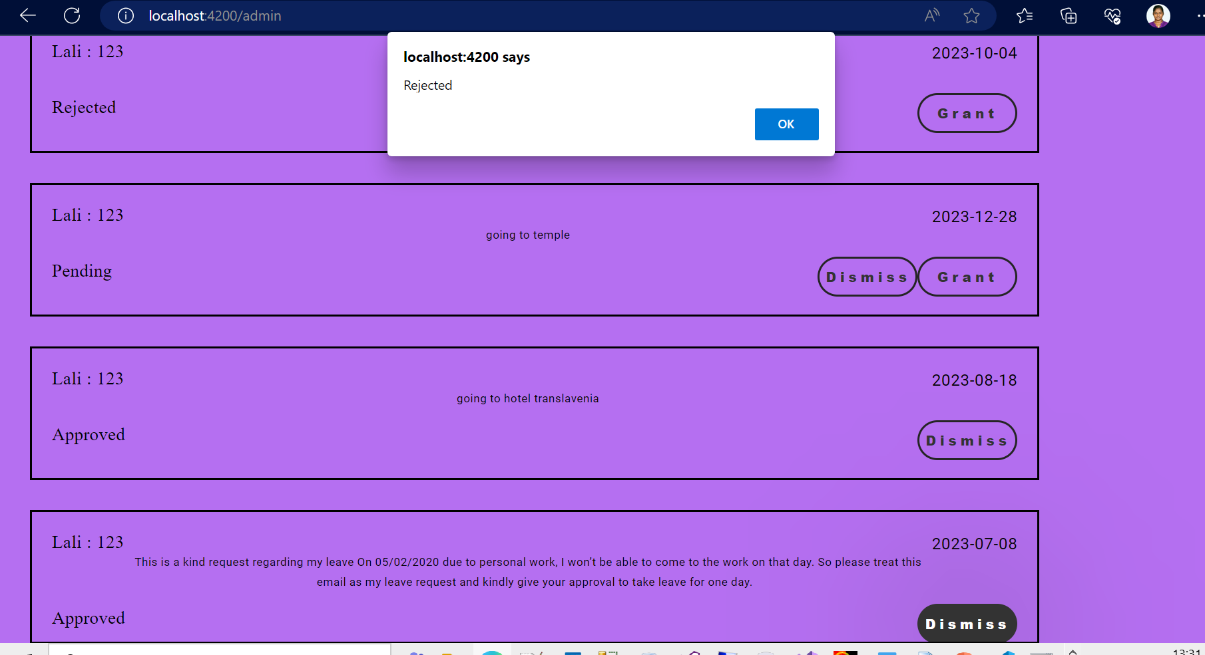
Admin view After clicking Dismiss

Slide 30
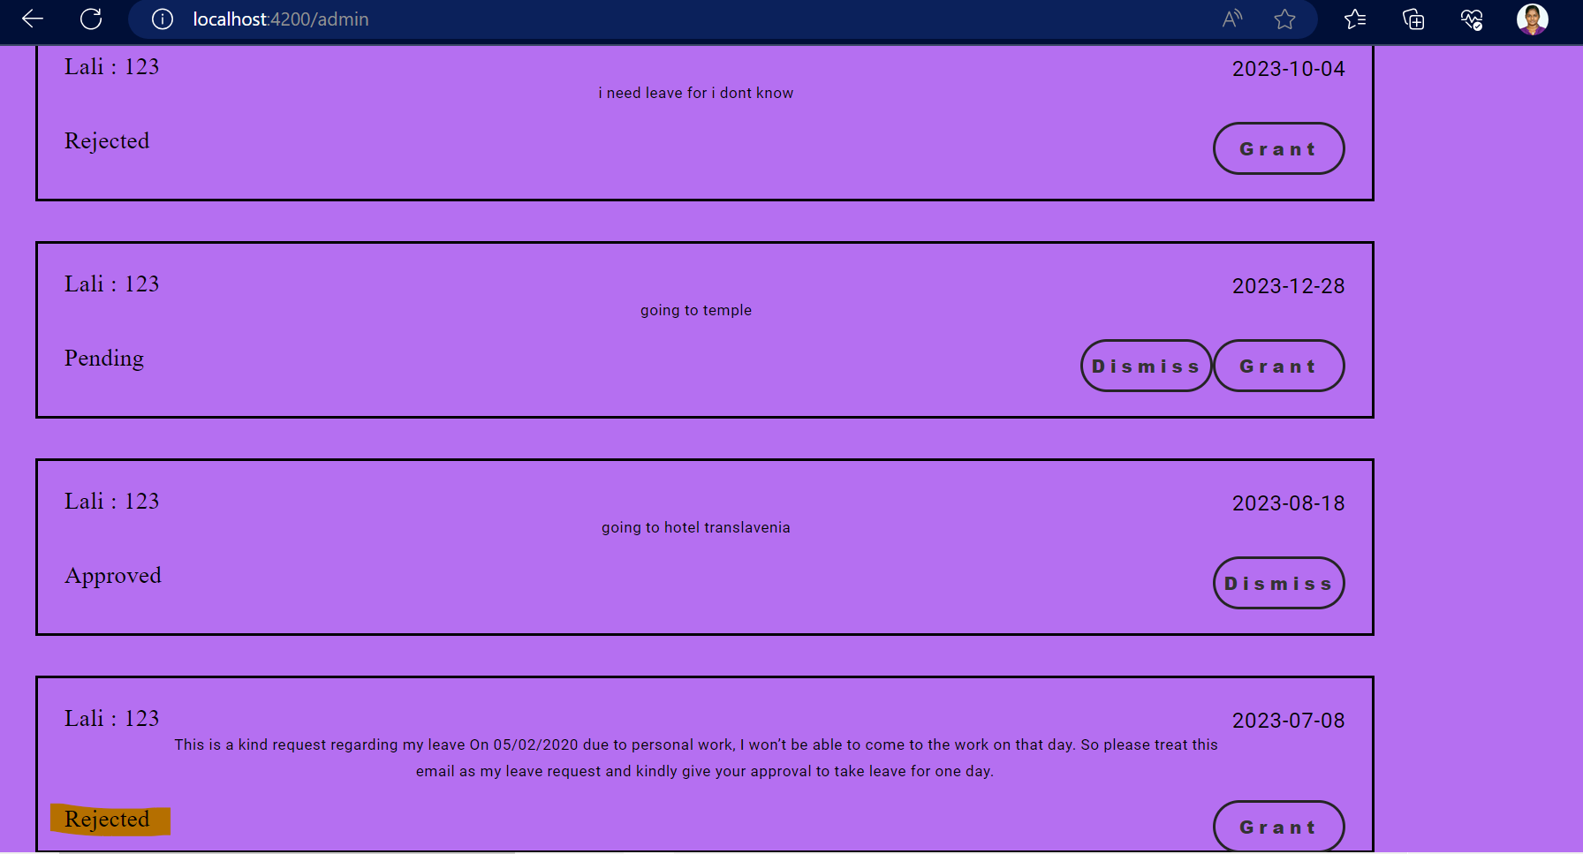

Slide 31
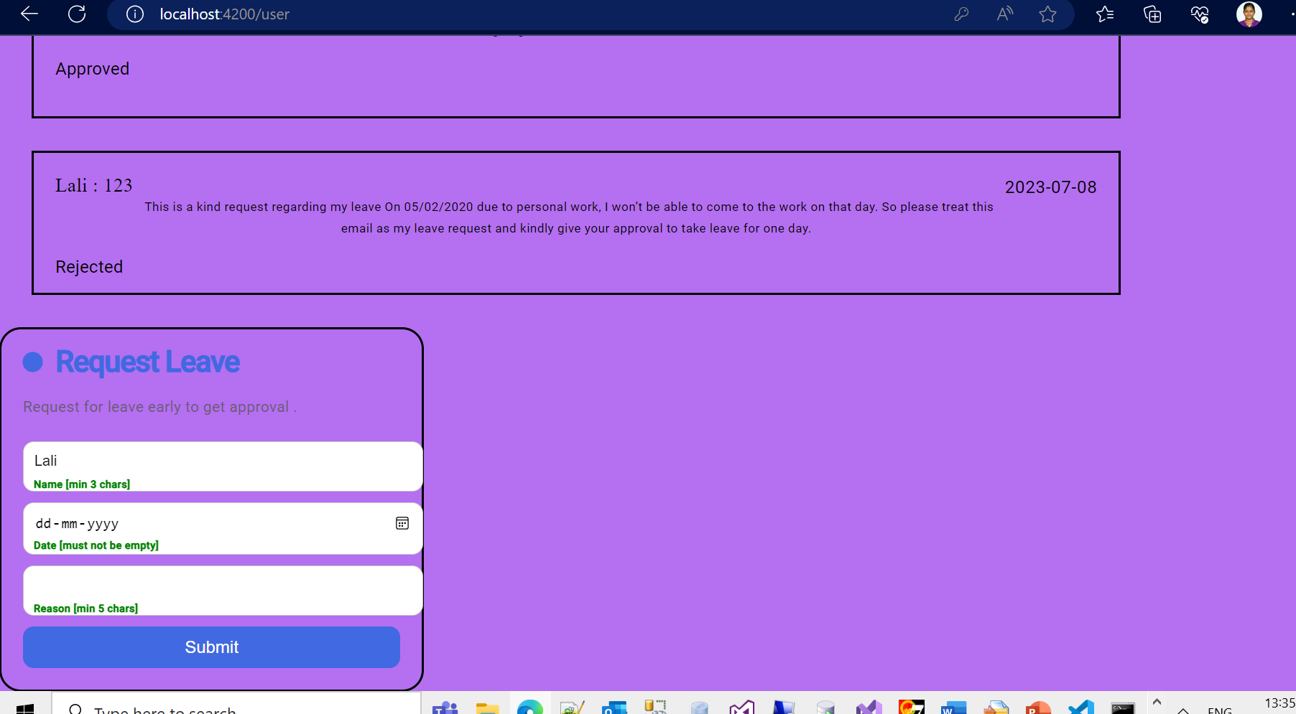
In User view after reject

Slide 32
Thanks Lalitha Shankar

